Slide 1
Data Preprocessing ——About data——
徐华
清华大学 计算机系 智能技术与系统国家重点实验室
xuhua@tsinghua.edu.cn

Slide 2
Data Preprocessing
About data
Why preprocess the data?
Descriptive data summarization
Data cleaning
Data integration and transformation
Data reduction
Discretization and concept hierarchy generation
Summary

Slide 3
What is Data?
Collection of data objects and their attributes
An attribute is a property or characteristic of an object
Examples: eye color of a person, temperature, etc.
Attribute is also known as variable, field, characteristic, or feature
A collection of attributes describe an object
Object is also known as record, point, case, sample, entity, or instance
Attributes
Objects

Slide 4
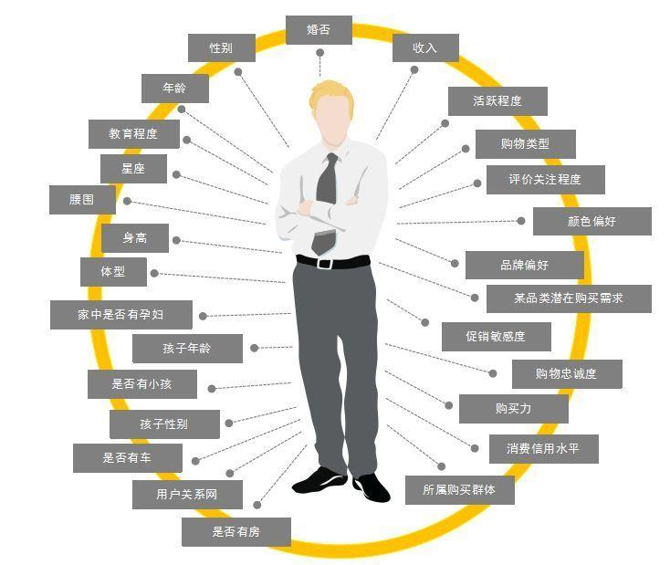
Attribute Values
Attribute values are numbers or symbols assigned to an attribute
Distinction between attributes and attribute values
Same attribute can be mapped to different attribute values
Example: height can be measured in feet or meters
Different attributes can be mapped to the same set of values
Example: Attribute values for ID and age are integers
But properties of attribute values can be different
ID has no limit but age has a maximum and minimum value

Slide 5
Types of Attributes
There are different types of attributes
Nominal (名称性的)
Examples: ID numbers, eye color, zip codes
Ordinal (顺序的)
Examples: rankings (e.g., taste of potato chips on a scale from 1-10), grades, height in {tall, medium, short}
Interval (区间型的)
Examples: calendar dates, temperatures in Celsius or Fahrenheit.
Ratio (比率型的)
Examples: temperature in Kelvin, length, time, counts

Slide 6
Properties of Attribute Values
The type of an attribute depends on which of the following properties it possesses:
Distinctness: = ≠
Order: < >
Addition: + -
Multiplication: * /
Nominal attribute: distinctness
Ordinal attribute: distinctness & order
Interval attribute: distinctness, order & addition
Ratio attribute: all 4 properties

Slide 7
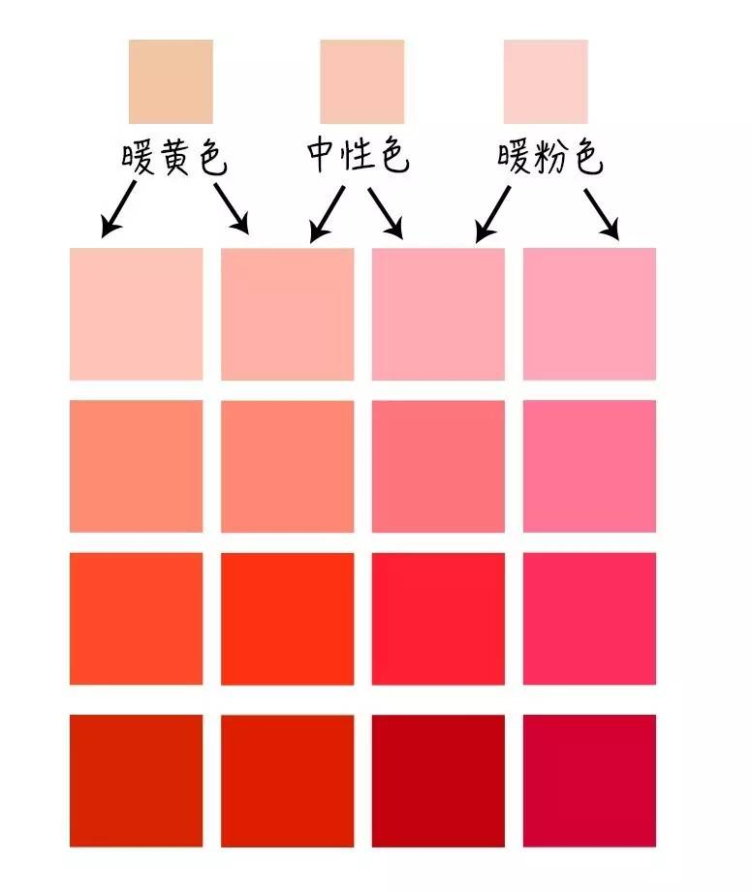


Discrete and Continuous Attributes
Discrete Attribute
Has only a finite or countably infinite set of values
Examples: zip codes, counts, or the set of words in a collection of documents
Often represented as integer variables.
Note: binary attributes are a special case of discrete attributes
Continuous Attribute
Has real numbers as attribute values
Examples: temperature, height, or weight.
Practically, real values can only be measured and represented using a finite number of digits.
Continuous attributes are typically represented as floating-point variables.

Slide 8
Types of data sets
Record
Data Matrix
Document Data
Transaction Data
Graph
World Wide Web
Molecular Structures
Ordered
Spatial Data
Temporal Data
Sequential Data
Genetic Sequence Data

Slide 9
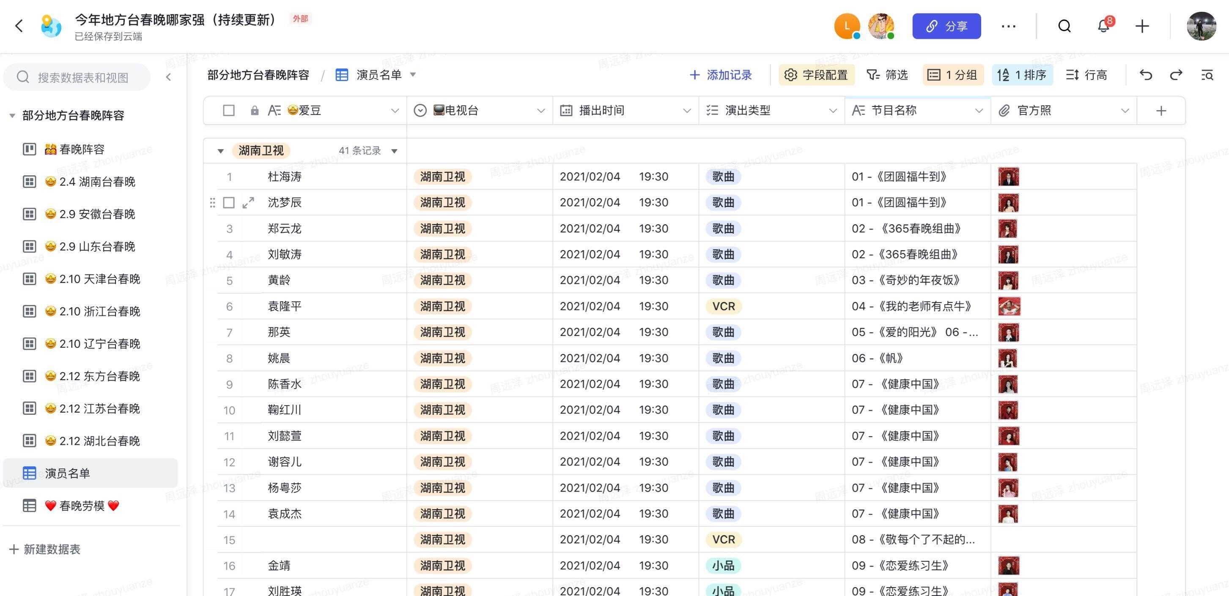
Important Characteristics of Structured Data
Dimensionality (维度)
Curse of Dimensionality (维数灾难)
Sparsity (稀疏)
Only presence counts
Resolution (分辨率，解析度)
Patterns depend on the scale

Slide 10
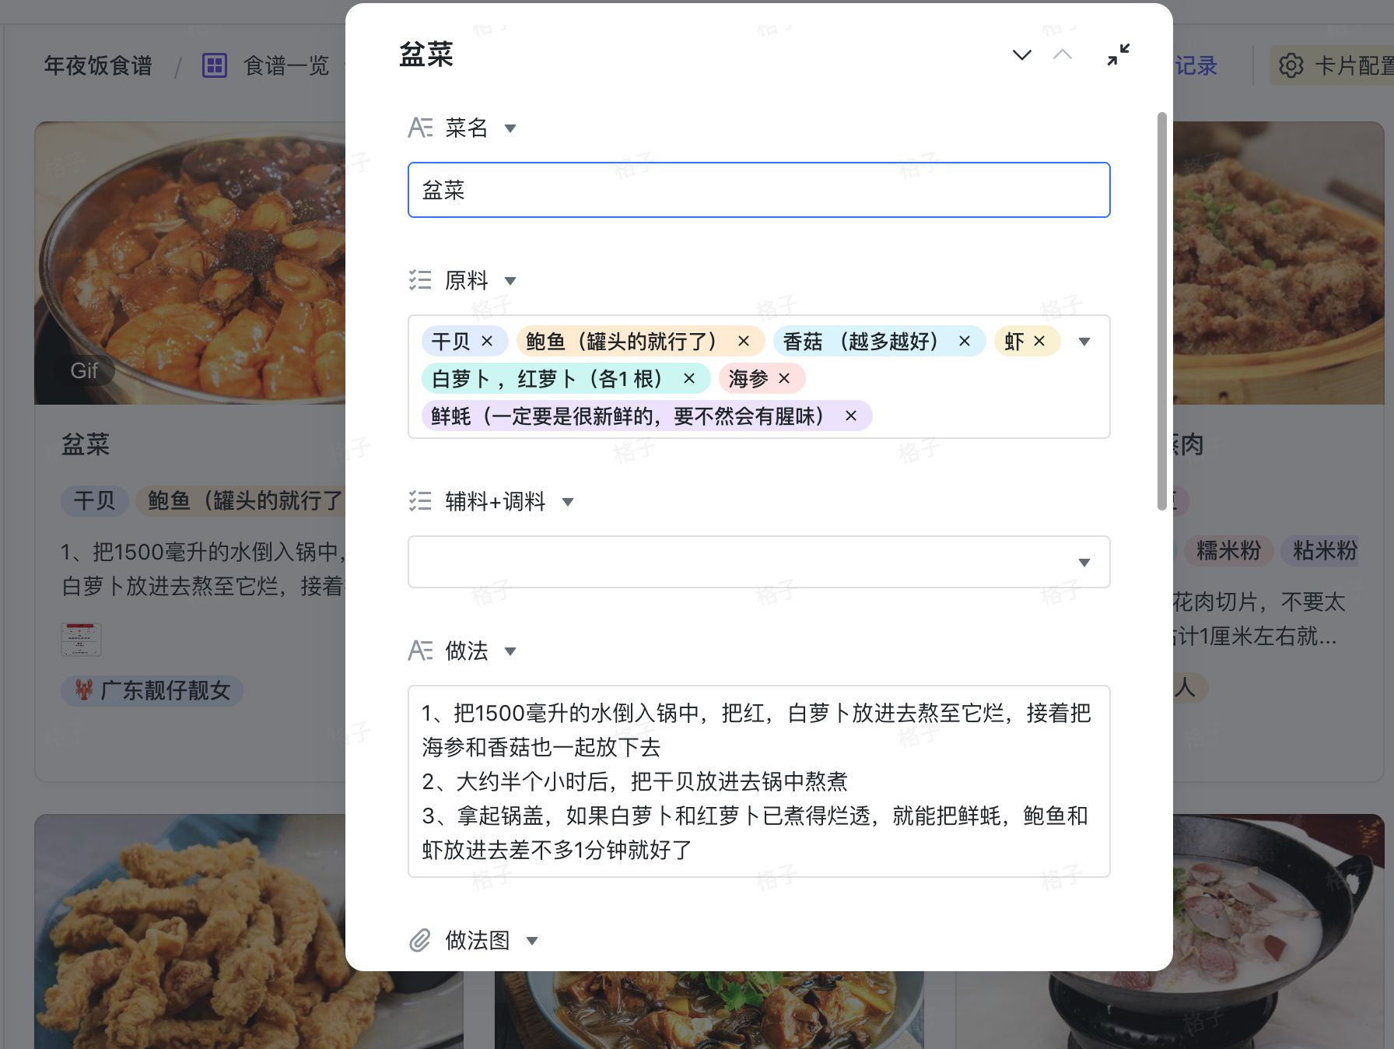
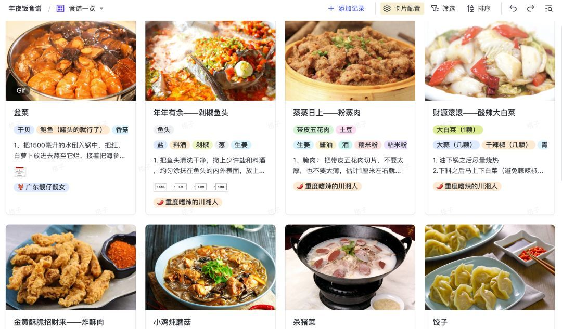
Important Characteristics of Structured Data

Slide 11
Record Data
Data that consist of a collection of records, each of which consists of a fixed set of attributes

Slide 12
Data Matrix
If data objects have the same fixed set of numeric attributes, then the data objects can be thought of as points in a multi-dimensional space, where each dimension represents a distinct attribute
Such data set can be represented by an m by n matrix, where there are m rows, one for each object, and n columns, one for each attribute

Slide 13
Document Data
Each document becomes a `term' vector,
each term is a component (attribute) of the vector,
the value of each component is the number of times the corresponding term occurs in the document.

Slide 14
Transaction Data
A special type of record data, where
each record (transaction) involves a set of items.
For example, consider a grocery store. The set of products purchased by a customer during one shopping trip constitute a transaction, while the individual products that were purchased are the items.

Slide 15

Graph Data
Examples: Generic graph and HTML Links

Slide 16
Chemical Data
Benzene Molecule (苯分子): C₆H₆

Slide 17
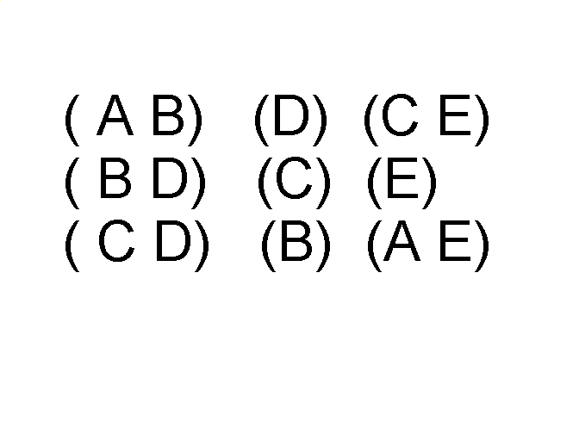
Ordered Data
Sequences of transactions
Items/Events
An element of the sequence

Slide 18
Ordered Data
Genomic（染色体） sequence data

Slide 19
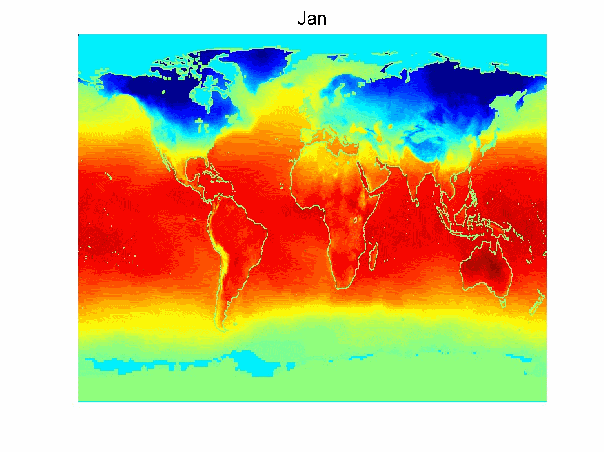
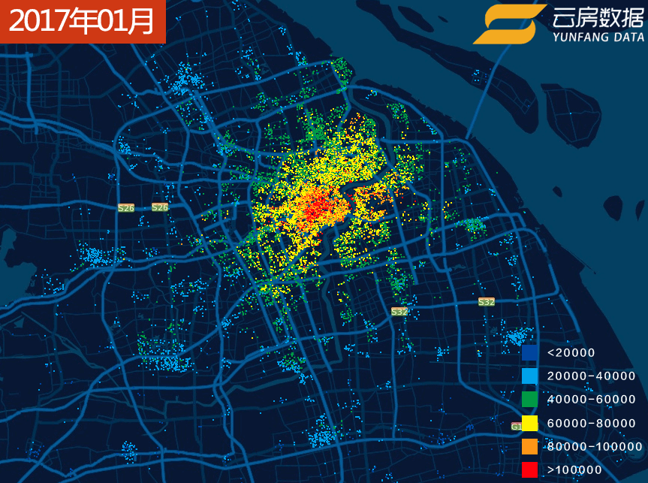
Ordered Data
Spatio-Temporal Data
Average Monthly Temperature of Land and Ocean Heat map of human flow

Slide 20

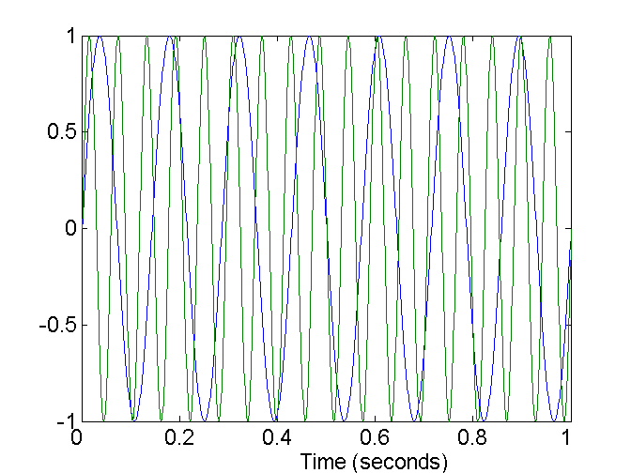
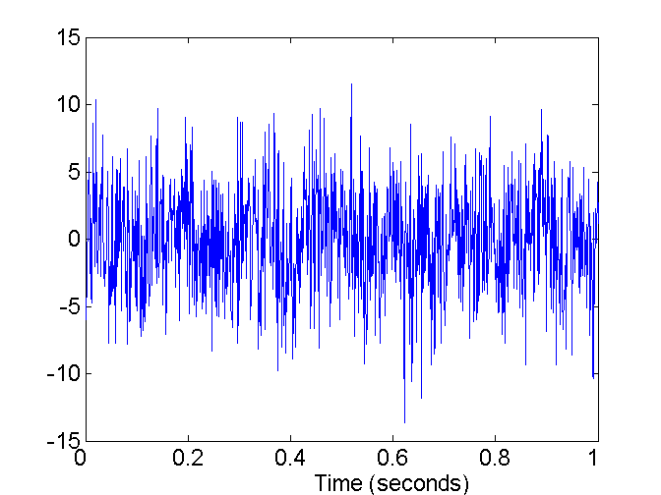
Data Quality
What kinds of data quality problems?
How can we detect problems with the data?
What can we do about these problems?
Examples of data quality problems:
Noise and outliers
Missing values
Duplicate data
Two Sine Waves
Two Sine Waves + Noise
Outliers

Slide 21
Thanks！
Notes:
工作新意图发现

